Slide 1
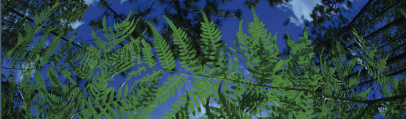



BiotaPhy:
An Overview
Doug Soltis
University of Florida
BiotaPhy

Slide 2

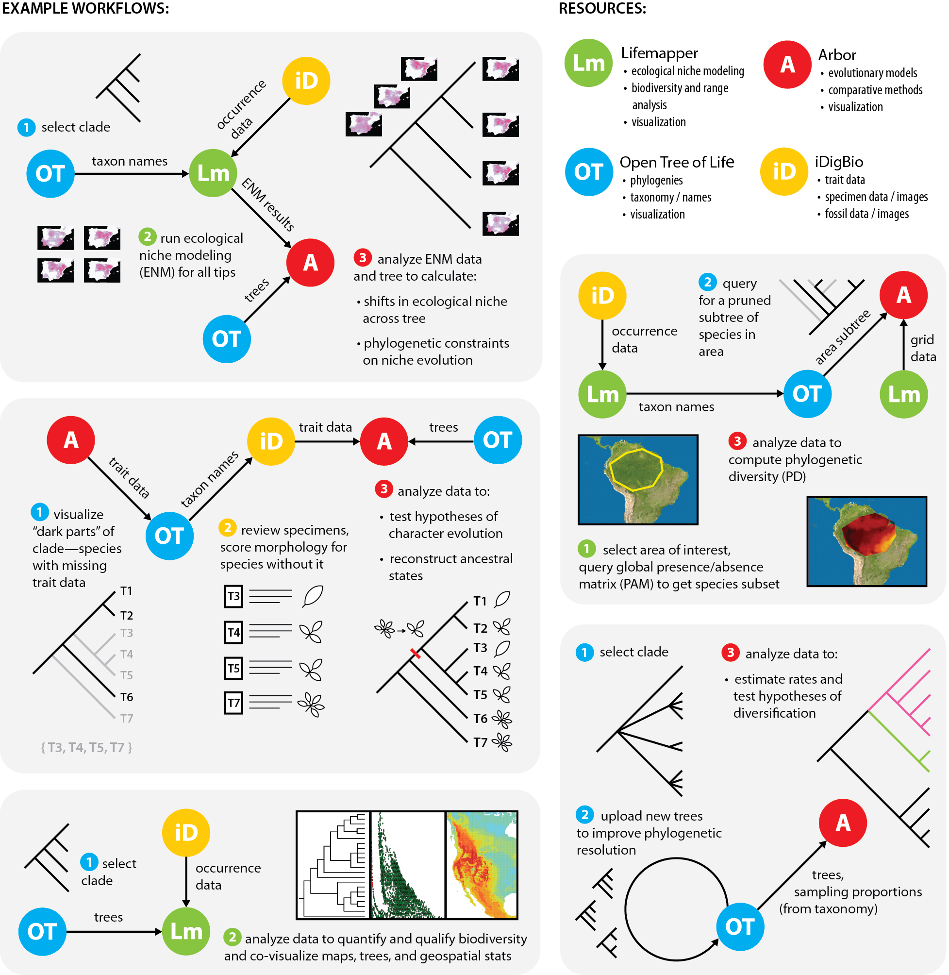
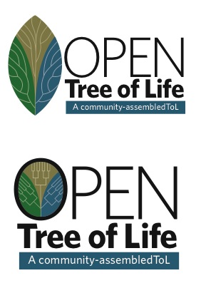
Linking Heterogeneous Data:
Connecting Specimens, Trees, Tools
BiotaPhy Project:
Connecting resources
to enable large-scale biodiversity analyses
J. Beach, D. Soltis, P. Soltis, J. Fortes,
S. Smith, R. Folk
Analytical Tools
Notes:
What we want to do today is highlight some of the exciting workflows our team is developing –so that you can see some of the possibilities that you may want to implement yourselves…using our platform deliverables and what ultimately should be easy to use workflows.. As originally conceived the goal of our first NSF-funded Biotaphy project was to connect specimens, trees, tools.. In Biotaphy 2—our current funding—we want to make workflows more accessible to the community

Slide 3
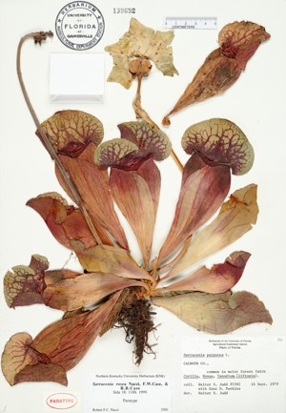
Label Data (Occurrences)
Scientific name
Date
Collector
Location – state, county,
specific site,
GPS coordinates
Associated species

Slide 4

Trees

Slide 5
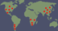




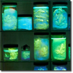


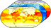
Lifemapper: Species Distribution Modeling
Species Occurrence Data
Predicted Habitat
Environmental Data
Notes:
Lifemapper calculates predicted habitat models using occurrence and environmental data---niche models on the fly

Slide 6
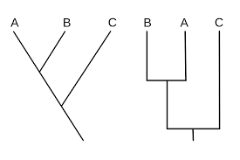

A Project in Need of a Logo
Connectivity
Notes:
Finally—Biotaphy vs Biotaffy

Slide 7
Connecting Specimens, Trees, Tools
5 Possible Workflows
Analytical Tools
C. Hinchliff
Notes:
In our original biotaphy proposal we proposed 5 possible workflows that we wanted to implement I know you can’t read these …so I will zoom in on a few

Slide 8
Connecting Trees, Specimens, Tools
Ancestral Niche
Analytical Tools
Notes:
One workflow that has been of great interest is to reconstruct ancestral niche. You have a Clade of interest- we need taxon names (OT) and occurrence data (iDigBio)— we can use those data to build niche models for all the tip species We also need a tree (build one or download one) and we can now examine niche shifts across the tree and look at phylogenetic constraints on niche evolution

Slide 9
Spatial Phylogenetics
Notes:
Another workflow of interest involves studies of spatial phylogenetics. A researcher selects an area of interest- here the Amazonian region but if could be Florida or a watershed in Ohio. You need a species list - occurrence data for those species. - and you need a tree for just those species. That tree can be obtained by pruning an existing tree to match your species list. You can then compute phylogenetic diversity (PD)-

Slide 10

Phylogenetic Diversity (PD):
How much of the Tree of Life is present in an area?
Oaks
Vs.
Notes:
Hannah will tell you more about PD next

Slide 11
PD: Genera of China Angiosperms
Low PD
High PD

Slide 12
Trait Evolution

Slide 13
BiotaPhy 2: Goals
BiotaPhy Platform: community biodiversity gateway for data- intensive science
Increase accessibility and use of Open Tree of Life, iDigBio, and Lifemapper
A sustainable, long-term, biodiversity community infrastructure
Workshops
Notes:
The goal of Biotaphy 2 is to make workflows like these - and other workflows you will hear more about today- more readily available to general users. We want Our Biotaphy platform …

Slide 14
BiotaPhy 2 Workflows
Launched
Workflows:
Developed
Workflows:
Notes:
So here are some workflows that have been launched at the top. READ
at the bottom are workflows that we have developed and are ready to launch READ---Advanced PD (you will see these); ancestral niche and paleoclimate range– Ryan Folk

Slide 15
BiotaPhy: Architecture
Notes:
Here is the project architecture – functions and communication between biotaphy subsystems; what is under the hood that most users will not have to worry about. But the general idea is that there are various sorts of input data on the left as discussed. The data access manager (DAM) responds to external user communications through client interfaces / then distributes the data and jobs internally. Compute management directs jobs to and from the compute engine —the workhorse of the software …to execute workflows
CJ will answer any questions you might have about this!

Slide 16
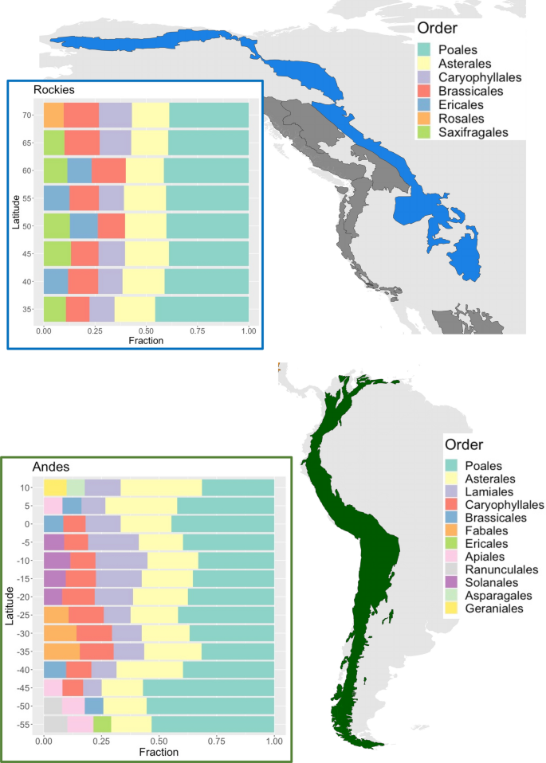
BiotaPhy: Big Project Applications
CJ Grady
Notes:
Here is the project architecture – functions and communication between biotaphy subsystems; what is under the hood that most users will not have to worry about. But the general idea is that there are various sorts of input data on the left as discussed. The data access manager (DAM) responds to external user communications through client interfaces / then distributes the data and jobs internally. Compute management directs jobs to and from the compute engine —the workhorse of the software …to execute workflows
CJ will answer any questions you might have about this!

Slide 17
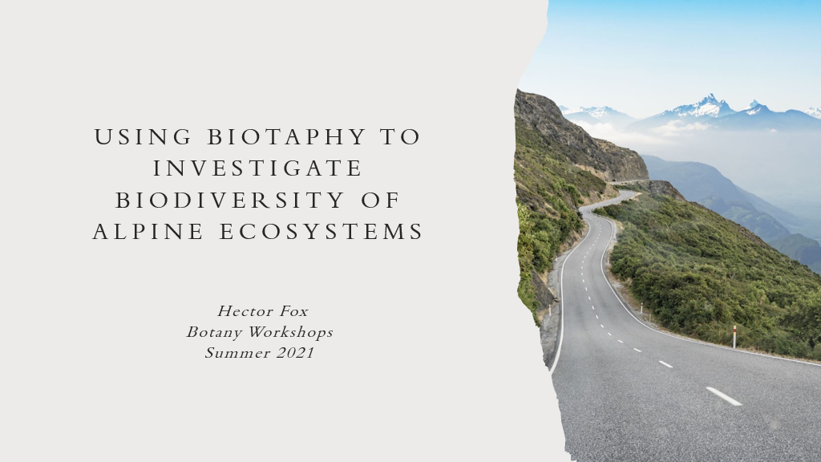
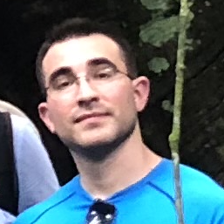
Figueroa et al. 2022. Contrasting patterns of phylogenetic diversity and alpine specialization across the alpine flora of the American mountain range system. Alpine Botany 132, 107–122 https://doi.org/10.1007/s00035-021-00261-y

Slide 18
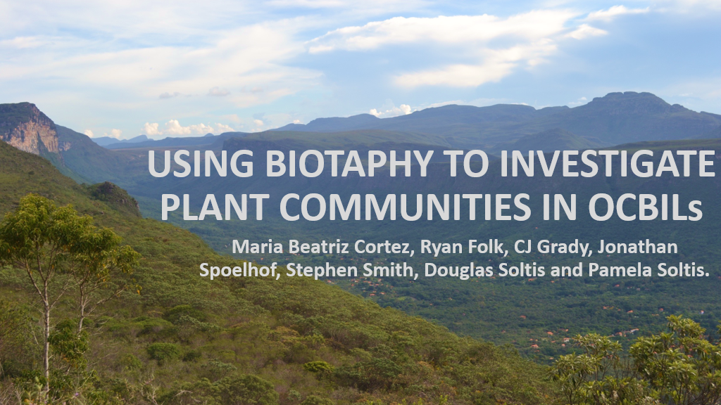
De Souza Cortez et al. 2020. Is the age of plant communities predicted by the age, stability and soil composition of the underlying landscapes? An investigation of OCBILs. Biological Journal of the Linnean Society 133: 297-316.
Old Climatically staBle Infertile Landscapes

Slide 20
BiotaPhy
Webinar Series
Data Use Skills
Featuring Data from Natural History Collections
September 21-November 30, 2022
https://www.idigbio.org/content/biotaphy-2022-webinar-series
Notes:
Hi everyone, Welcome to today’s webinar!
My name is Pam Soltis, and I’m a curator in the Florida Museum of Natural History at the University of Florida. I’m also one of the co-Pis of the BiotaPhy project.
Today’s webinar is the 7th in a 10-part series that focuses on uses of natural history collection data for various research applications and the skills needed to do this research. Details of the BiotaPhy project and the webinar program and topics covered can be found in the recording of Webinar 1 and on the website.
We will run the webinar through Nov 30, taking a break on Nov 23 for Thanksgiving. We ask that you register for each session separately. That helps us track interest in the different topics, stay in touch with specific attendees, and so on. If you can’t make a session, no problem – we will record all sessions, and the recordings will be posted on the info page hosted by iDigBio.
Also, if you haven’t already had a chance to do so, you may want to take a look at ‘Webinar 0’, which provides an introduction to terms and concepts that will be used throughout the series. It’s available as a pdf on the webinar series info page.
Information on the series, and opportunities to register for later sessions, can be found at this link. We’ll post it in the chat during today’s presentation.

Slide 21
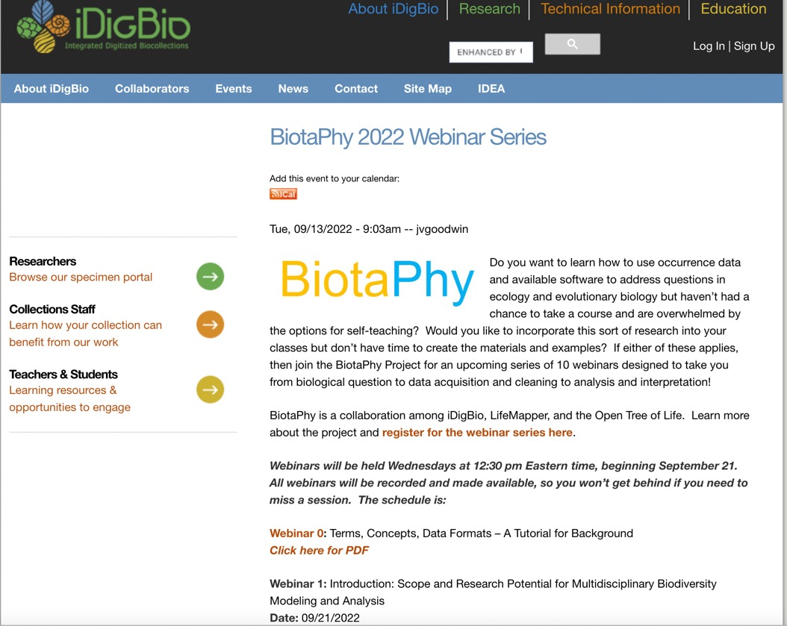
BiotaPhy
iDigBio:
https://www.idigbio.org/content/biotaphy-2022-webinar-series
iDigBio.org
Notes:
As a reminder, here is a screenshot of the webinar info page. If you ever need to find this page, you can go to idigbio.org and search for biotaphy, and the link will come up.
Links to the recordings of each webinar are also posted on this page.

Slide 22
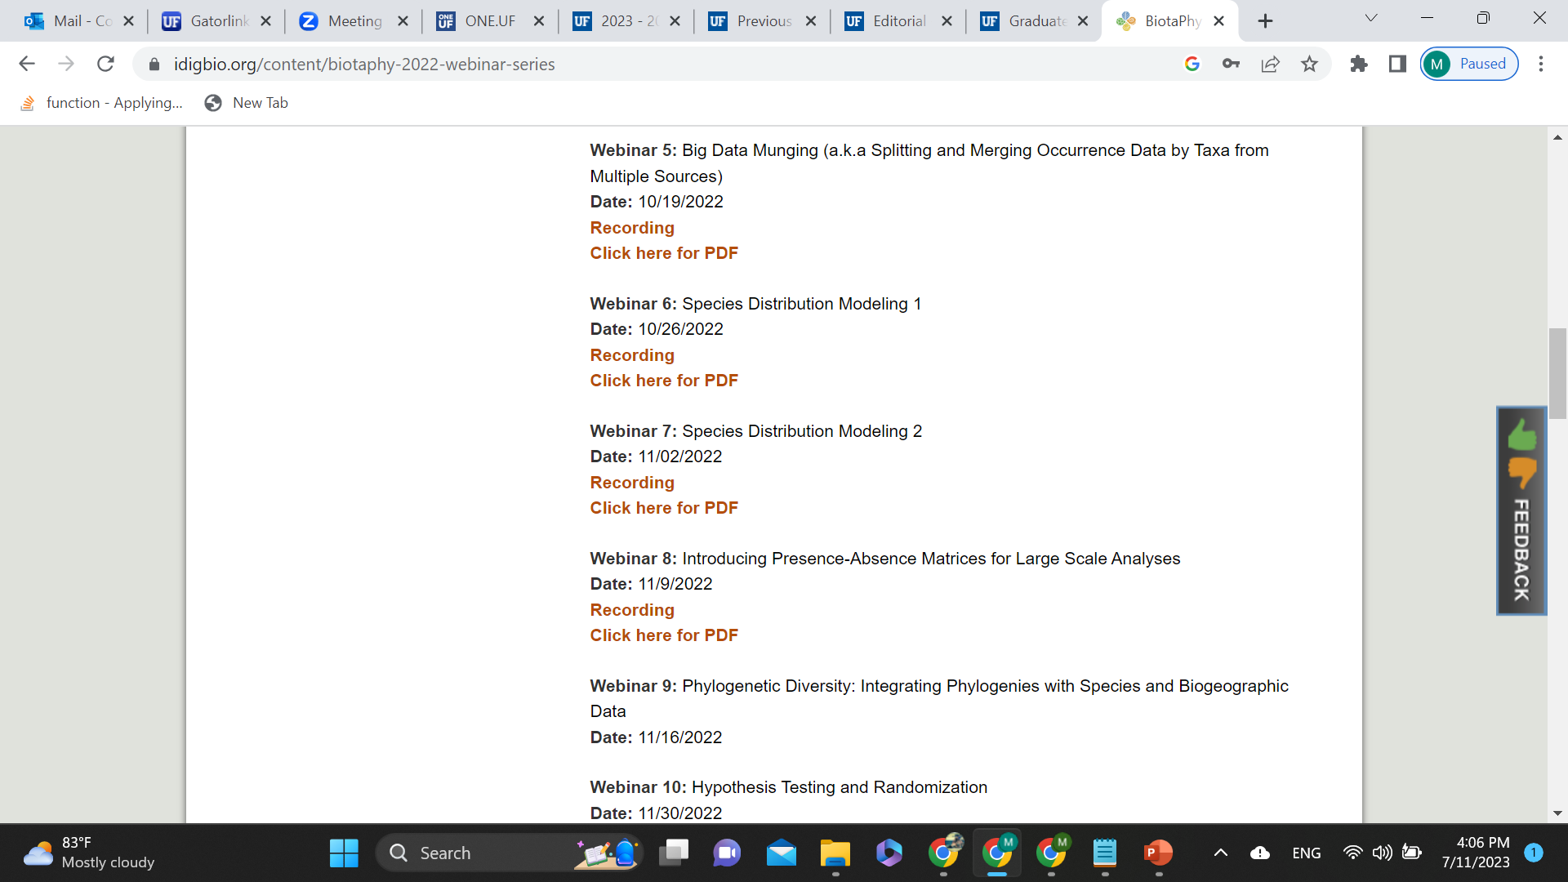
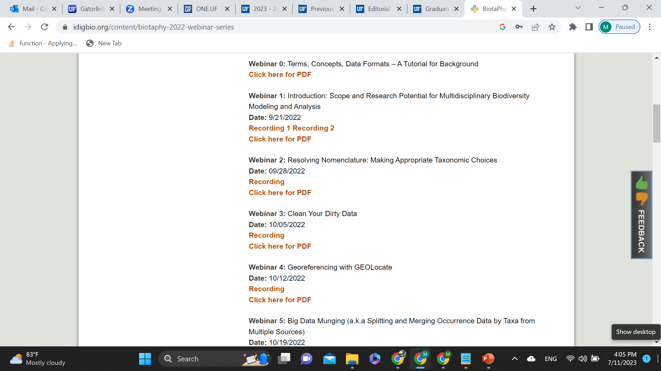
BiotaPhy

Slide 23
BiotaPhy
Webinar 0
Terms, Concepts, Data Formats –
A Tutorial for Background

Slide 24
Goals
BiotaPhy
Introduce the technical terminology that will be used throughout the webinars
Webinar 0

Slide 25
BiotaPhy
Webinar 1
Introduction: Scope and Research Potential for Multidisciplinary Biodiversity Modeling and Analysis

Slide 26
Goals
BiotaPhy
Introduce biological and computational workflow concepts for integrating:
biological specimen (species occurrence) data, phylogenetic trees, and multi-species distribution models!
Webinar 1

Slide 27
BiotaPhy
Webinar 2
Resolving Nomenclature:
Making Appropriate Taxonomic Choices

Slide 28
Goals
BiotaPhy
Learn why and how to treat nomenclatural data that will be used in multiple biodiversity analysis
Webinar 2

Slide 29
BiotaPhy
Webinar 3
Clean Your Dirty Data

Slide 30
Goals
BiotaPhy
Introduce the importance of cleaning
data before processing biodiversity
analyses and practice a few ways to do so
Webinar 3

Slide 31
BiotaPhy
Webinar 4
Georeferencing with GEOLocate

Slide 32
Goals
BiotaPhy
How to use locality information in specimen records to obtain georeferences (i.e., latitude and longitude)
Webinar 4

Slide 33
BiotaPhy
Webinar 5
Big Data Munging: Finding, Acquiring, and Preparing Species Occurrence Data and Tree Data

Slide 34
Goals
BiotaPhy
Learn how to find, manipulate, combine and use occurrence and tree data in biodiversity analyses
Webinar 5

Slide 35
BiotaPhy
Webinar 6
Species Distribution Models: What are they? How to Create One?

Slide 36
Goals
BiotaPhy
Create Species Distribution Models using Maxent using occurrence data with the minimum number of points defined in the configuration file or the Rare Species Model algorithm for data without the required minimum number of points.
Webinar 6

Slide 37
BiotaPhy
Webinar 7
Species Distribution Models:
Interpretation and Ancestral Niche Reconstruction

Slide 38
Goals
BiotaPhy
Learn how to interpret species distribution models build using Maxent, and how to perform ancestral niche reconstruction
Webinar 7

Slide 39
BiotaPhy
Webinar 8
Introducing Presence-Absence Matrices for Large Scale Analyses

Slide 40
Goals
BiotaPhy
Learn how to calculate basic diversity statistics and how to utilize a Presence and Absence Matrix (PAM) to optimize calculations involving multiple taxa
Webinar 8

Slide 41
BiotaPhy
Webinar 9
Phylogenetic diversity: Integrating Phylogenies with Species and Biogeographic Data

Slide 42
Goals
BiotaPhy
Integrate phylogenetic trees and species distribution models to understand modern day diversity patterns using a species PAM.
Webinar 9

